Slide 1
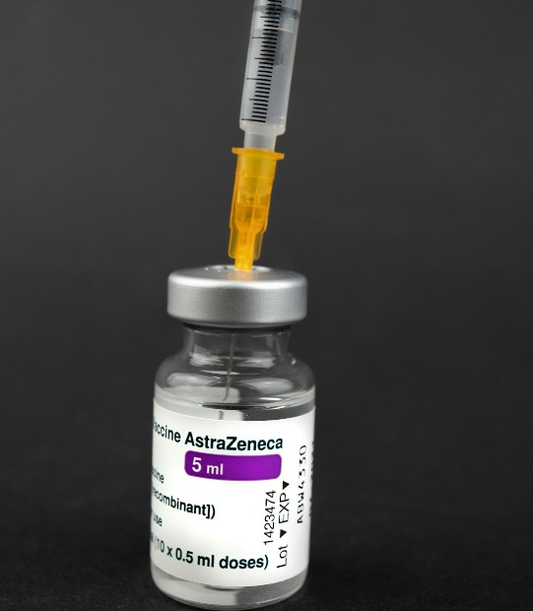
Predicting Vaccine Uptake
NAME: Franciscar N. DATE: DEC 2024

Slide 2


Project Overview
PREDICTING VACCINE UPTAKE
This project leverages machine learning to predict vaccine uptake. It employs data from the DrivenData competition, focusing on demographic and health-related features. The approach frames the challenge as a classification problem and showcases a complete data pipeline.

Slide 3

Business Problem
UNDERSTANDING VACCINATION BEHAVIORS
RISKS OF UNVACCINATED POPULATIONS
Understanding the reasons behind vaccination behaviors is critical. These insights enable health organizations to design effective interventions that can target specific populations prone to vaccine hesitancy.
Unvaccinated groups pose significant risks. It's crucial for community health and safety to address these vulnerabilities through informed policy measures.

Slide 4


Key Questions
STRATEGIES FOR INCREASED UPTAKE
What effective strategies can public health organizations implement to boost vaccination rates and mitigate the spread of infectious diseases?
FACTORS INFLUENCING VACCINATION
What demographic, behavioral, or health-related factors most significantly influence an individual’s decision to vaccinate against H1N1 and seasonal flu?
IDENTIFYING HIGH-RISK GROUPS
How can predictive modeling be used to pinpoint which populations are at greater risk of skipping vaccinations, thereby enhancing targeted health interventions?

Slide 5

Objective and Goals
DEVELOPING PREDICTIVE MODELS
The primary objective is to develop models predicting the likelihood of individuals receiving the H1N1 and seasonal flu vaccines. By accurately predicting vaccine uptake, these models aim to provide actionable insights for public health initiatives.

Slide 6

Data Sources
Data comes from the NHFS, focusing on legal use limitations while highlighting demographics and health features. Restrictions ensure privacy and compliance with legal standards.
SOURCE | NATIONAL 2009 H1N1 FLU SURVEY (NHFS)
Access Restrictions | Statistical analysis only
Legal Compliance | No identification of individuals
Data Linking | Prohibited with identifiable data
Key Features | Demographics, behavior, health

Slide 7
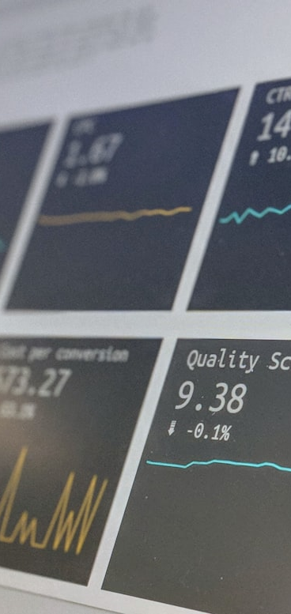

Modeling Techniques
DECISION TREES
Decision Trees split the data into subsets based on value criteria, providing visually interpretable models. They capture interactions among predictor variables efficiently.
LOGISTIC REGRESSION APPROACH
Logistic Regression is widely used for binary classification problems. It models the probability of a binary outcome using predictor variables. It's highly interpretable, making it easy to understand which factors influence decisions.

Slide 8
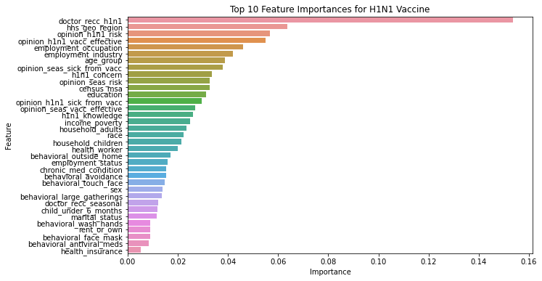
Factors influencing Vaccination

Slide 9
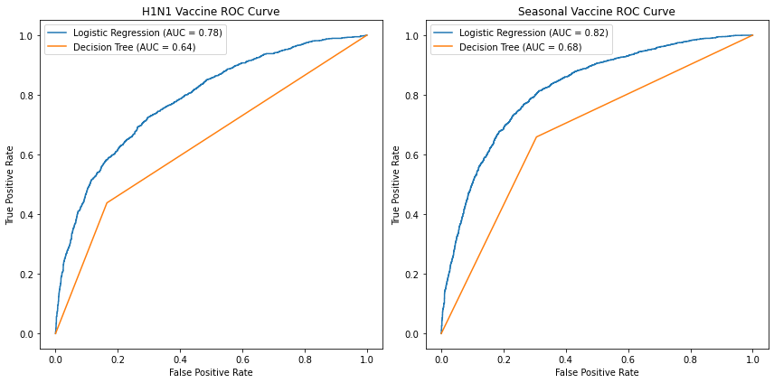
Performance Metrics

Slide 10


Insights & Implications
INFORM PUBLIC HEALTH STRATEGY
Insights from models reveal key demographic and behavioral predictors of vaccine uptake. Public health strategies can be tailored by understanding these factors. Addressing hesitancy and improving outreach efforts are critical to enhancing vaccine rates.

Slide 11

Conclusion & Strategies
SUMMARIZING KEY FINDINGS
The project effectively demonstrates that machine learning models can predict vaccine uptake accurately. Identifying influential factors helps understand barriers and motivations behind vaccination decisions.
PROPOSING ACTIONABLE STRATEGIES
To increase vaccine acceptance, strategies such as targeted awareness campaigns, personalized communication, and incentivizing vaccinations should be considered by health organizations.

